Slide 1


Team G27
Own the Second Purchase
Turning viral first buyers into repeat customers with the same $120M
24% → 31%
−12 to −14%
$0
90-day repeat
blended CAC
new budget
Retargeting and lifecycle strategy · Grounded in Adobe Customer Journey Analytics
Case Competition World Cup · Graduate Track · October 2026

Slide 2


14 programs win the second purchase at $0 new budget
G27
90-day repeat
Target ≥ 30%
Move $9M of the fixed $120M from rented to owned reach; earn the second purchase when trust peaks
24% → 31%
1 Capture every buyer
2 Win the Golden Month
3 Never pay twice
Turn every order into a relationship
Earn the second order in weeks 1–4
Pay only for customers who are incremental
Blended CAC
Target −10%
−12 to −14%
★ Quince Passport
★ Material Journeys
★ Never Pay Twice Engine
Care Calendar
Track It in the App
Gift Ledger
Loyalist Lookalikes
Contribution
Same $120M
Saved Cart
Quince Insider
Proof Creators
+$25M / yr
Restock-First Waitlist
Beauty Refill
The Fitting Room (pop-up)
Cashmere Second Life
No budget increase
+4.8 pts repeat
+3.3 pts repeat
Frees $9M · +0.9 pts
No price-led retention
Trust thread The first order buys trust; the second spends it. Proof and access, never discounts
Adobe CJA engine B funds → A builds → C proves. No money moves until a CJA holdout proves it
Every move proven in CJA
Market
Rented reach costs more every year
Customer
Buyers leave at three moments
Competition
Trust and consent take years to copy
Capabilities
Data ready; lifecycle muscle to build
Next steps
Prove in 90 days, scale by month 9
Source: Adobe CJA (Quince case data view, Jan–Apr 2026); case Exhibits D, G, H, J; team analysis. Impact figures are team estimates; repeat contributions are gross before haircuts.
Team G27 · 2

Slide 3







Rented reach costs more each year; owned reach compounds
G27
60% of budget sits on three social platforms
Blended CAC is up 29% in two years
Owned customers are worth 2.6× more
FY2026 paid marketing budget, $120M
Blended customer acquisition cost, $
Estimated 3-year LTV per customer, $
Paid social $72M = 60%
Owned $6M
$62
$410
$58M
$14M
$48
Prospecting
Search $22M
$155
Retargeting
Influencer $16M
Rules Quince doesn't control
Two years ago
Today
Web-only
App-installed
Signal loss exposes retargeting
Platform concentration
Weak demand, rising prices
iOS opt-in ~35–50%; Safari and Firefox block third-party cookies
Meta automates targeting by default; TikTok's U.S. ownership changed
Consumer sentiment at a record-low 44.8; tariffs lift costs
Retargeting's $31 CAC ignores sales that happen anyway; if half do, it is really $62
60% of reach follows rules Quince can't set or predict
Discounts would buy volume with the M2C margin, and are ruled out
Our move: Never Pay Twice Engine
Our move: owned share 5% → 11%
Our move: Insider and Proof Creators
Quince rents 60% of its reach and spends just $1.43 per customer on the reach it owns
Source: case Exhibits B, D, G, H; Adjust and AppsFlyer ATT benchmarks; University of Michigan consumer sentiment (May 2026); Meta and TikTok public announcements.
Team G27 · 3

Slide 4

Buyers leave at three moments; each needs its own move
G27
Top of funnel Landing → cart
Bottom of funnel Cart → order
After order one Order → second order
Landing
60,000
Add to cart
11,339
Not engaged
4.7%
Product view
36,566
Checkout
5,818
SMS after order
11.7%
Add to cart
11,339
Order
2,592
App after order
21.5%
69%
of product viewers leave without a cart add (CJA Fallout, Appendix 1)
77%
of carts never order; 1 message follows 11,610 cart adds (CJA Flow, Appendix 4)
4.6×
repeat for app users after order one; week-2 return 5.6% vs ~1% (Cohort, Appendix 3)
Why: Price signals quality
Why: Unfinished tasks fade
Why: Trust peaks at delivery
Half-price cashmere from a brand with no stores reads as too good to be true
A saved cart is forgotten within hours if nothing reminds the buyer
Habits form in weeks 1–4, and nobody buys a second sweater in spring
Our move
Our move
Our move
Proof Creators
Product-page proof
Saved Cart
Track It in the App
Quince Passport
Material Journeys
CJA also shows: cashmere buyers repeat at 13.7% vs Home 20.8%; owned channels assist 3× more revenue than last click credits (Appendix 2)
Reach abandoners within hours, every buyer at delivery, engaged buyers in weeks 1–4, and cashmere buyers by day 21
Source: Adobe CJA, case data view, Jan–Apr 2026, 60,000 people (A1, A2, A4, A5, A6, Cohort Table); behavioural mechanisms are hypotheses the pilot tests.
Team G27 · 4

Slide 5








Rivals copy tactics in a quarter; trust and consent take years
G27
What each rival teaches Quince
target
Copy the app's services (tracking, care, restock), not its app-only prices
Lifecycle email alone is no moat: Everlane was sold to Shein in 2026
Never fight a paid-retargeting war; Amazon wins it on data and scale
Owned customer relationship
Same price,
owned relationship
Own the customer data layer; never name rivals in messages (lawsuit)
CUYANA
Quince's moat: what takes years to copy
today
M2C cost
Consented base
Trust in hand
Direct factories
~480K newly engaged a year
Passport, Fitting Room
Value
Price position
Premium
If rivals escalate
Price war: hold price, prove quality and access
Retargeting bid war: already suppressed; owned share 5% → 11%
Copycat journeys: our lead is the consented, engaged base
Source: case Exhibit M; company filings and press (Shein acquisition of Everlane, May 2026; Williams-Sonoma v. Last Brand, dismissed 30 Sept 2026); positions are team judgment.
Team G27 · 5

Slide 6





The data is ready; the lifecycle muscle must be built
G27
Readiness today and at month 9, and what each unlocks
Operating model
Today
Month 9
Data and identity
Lever 1 · Capture
CRM and product
Unlocks: Never Pay Twice Engine, all 14 CJA tests
Analytics
Lever 2 · Golden Month
Lifecycle marketing
Activation and app
Lever 3 · Never pay twice
Paid media + analytics
Unlocks: Passport, Track It in the App, Saved Cart
Product + CRM
CJA engine
Weekly incrementality council
Lifecycle team and creative
Unlocks: Material Journeys, Care Calendar, Proof Creators
CMO
Funded inside the $120M: $7.5M
Measurement
Owned-channel build, $M
Unlocks: holdouts on every tranche, weekly council
$1.6M Lifecycle team
$1.0M Recovery, product proof
Head of Analytics
$1.5M Activation and sends
$0.5M Member perks
Incentives
$1.2M App: tracking, care
$0.5M Measurement
Unlocks: Lever 3, by scoring incremental revenue, not ROAS
$1.2M Creative
CMO + CFO
Exhibit I prices the core rebuild at $2–3M inside today's $6M line
Every gap closes with money already in the budget; changing the scorecard removes the biggest blocker
Source: case Exhibits I and L; team assessment of readiness; owned-channel build sized at ~$200K per lifecycle role (team estimate).
Team G27 · 6

Slide 7




Prove in 90 days, scale by month nine
G27
M0
Fitting Room test
M3
M6
M9
M12
M18
Reallocate
T1: −$4M retargeting
T2: −$3M search
T3: −$2M, only if proven
+$7.5M owned, +$1.5M creators
CFO, paid media
Launch programs
Pilot: Passport, Track It, Saved Cart, Engine
Material Journeys, Care Calendar, Gift Ledger, Insider, Proof Creators, Lookalikes
National rollout + Beauty Refill, Second Life, Waitlist; Midwest, Canada
CMO, CRM, product
Prove in CJA
Weekly incrementality council · 10% holdout in the South pilot · holdouts on every tranche
Head of Analytics
Pass: next tranche moves.
Fail: money goes back.
Gate 1
Gate 2
Target
Pilot beats holdout by 2+ pts on 30-day repeat
Repeat ≥ 28%, effective CAC ≤ $58
Repeat ≥ 30%, effective CAC ≤ $56
90-day repeat
Blended CAC
Retargeting efficiency
Monday: approve three things
Tranche 1, the South pilot, the weekly CJA council
We will not discount, add budget or cut prospecting without proof
24% → ≥ 30%
$62 → ≤ $56
Incremental orders per $
Source: team plan; gate thresholds from the team's strategy; timelines from case Exhibit I. Tranche 3 moves only if a holdout proves prospecting is over-credited.
Team G27 · 7

Slide 8
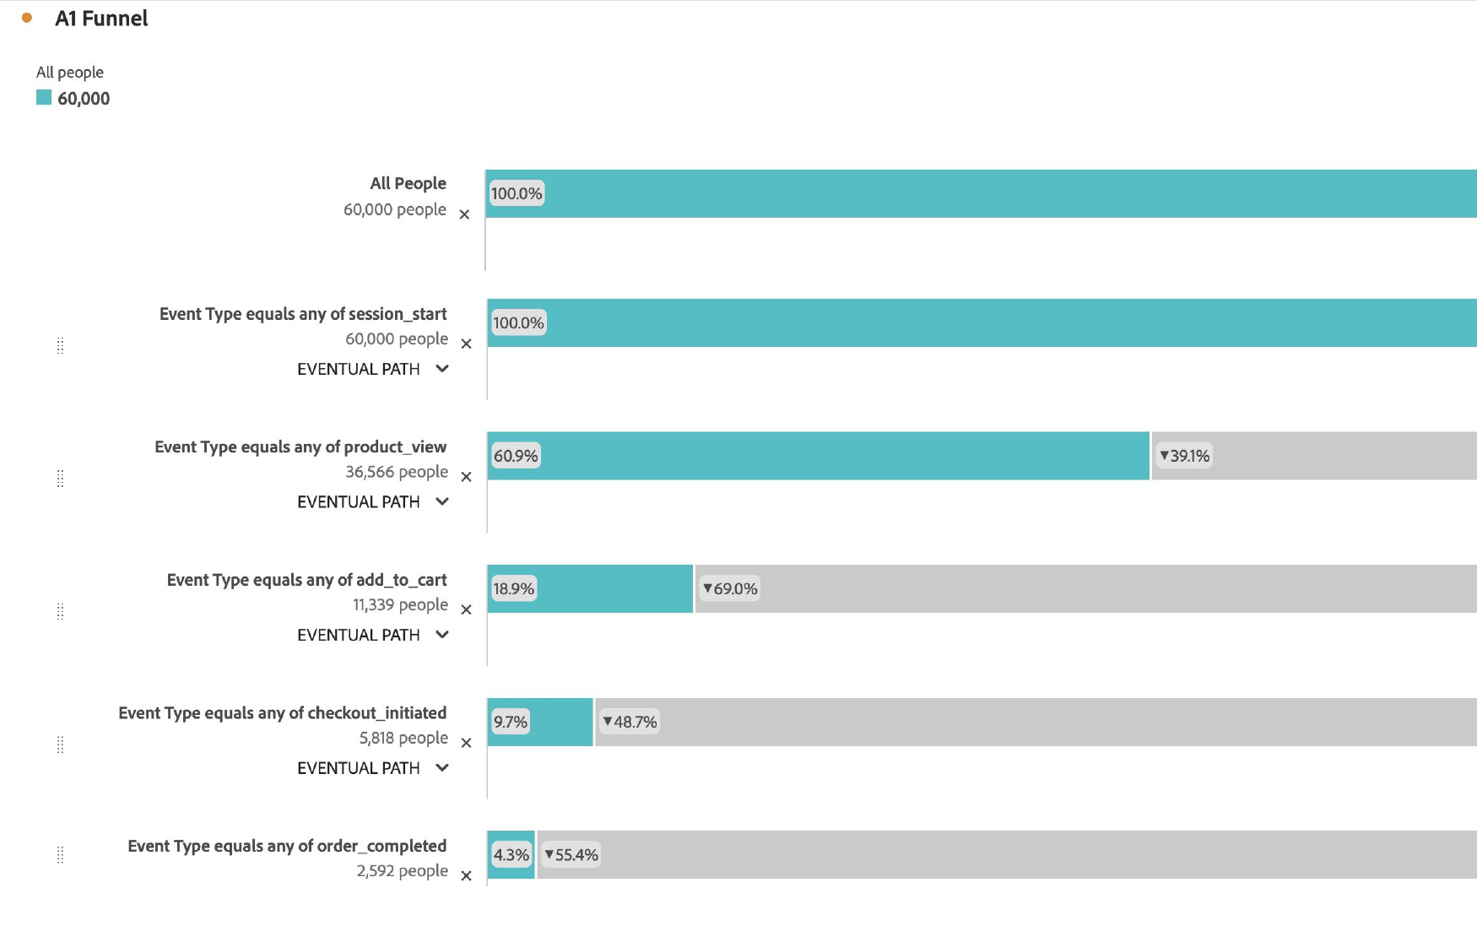
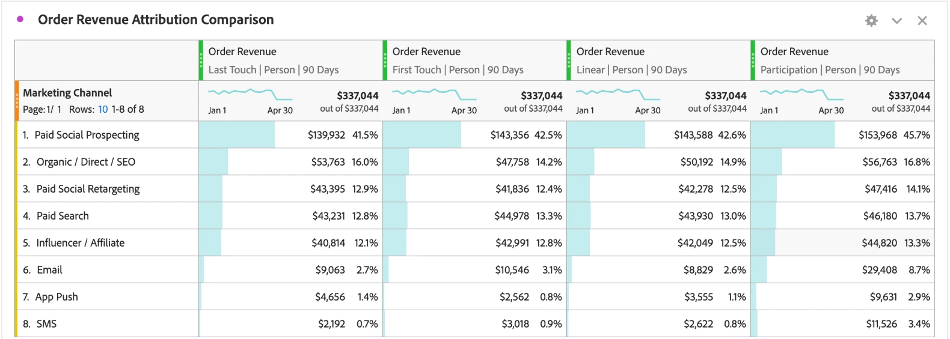
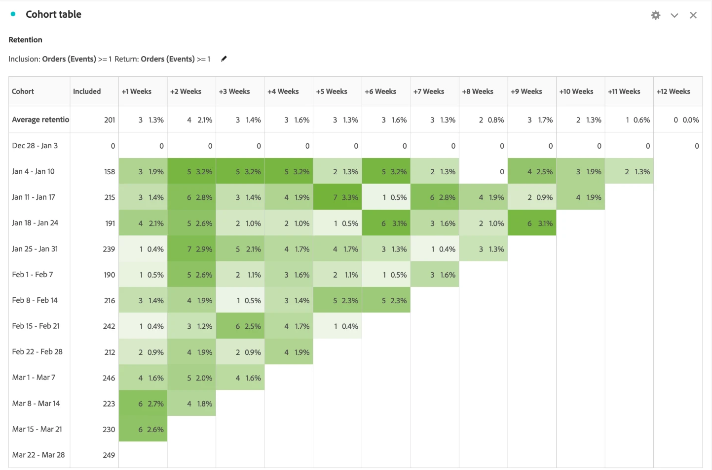
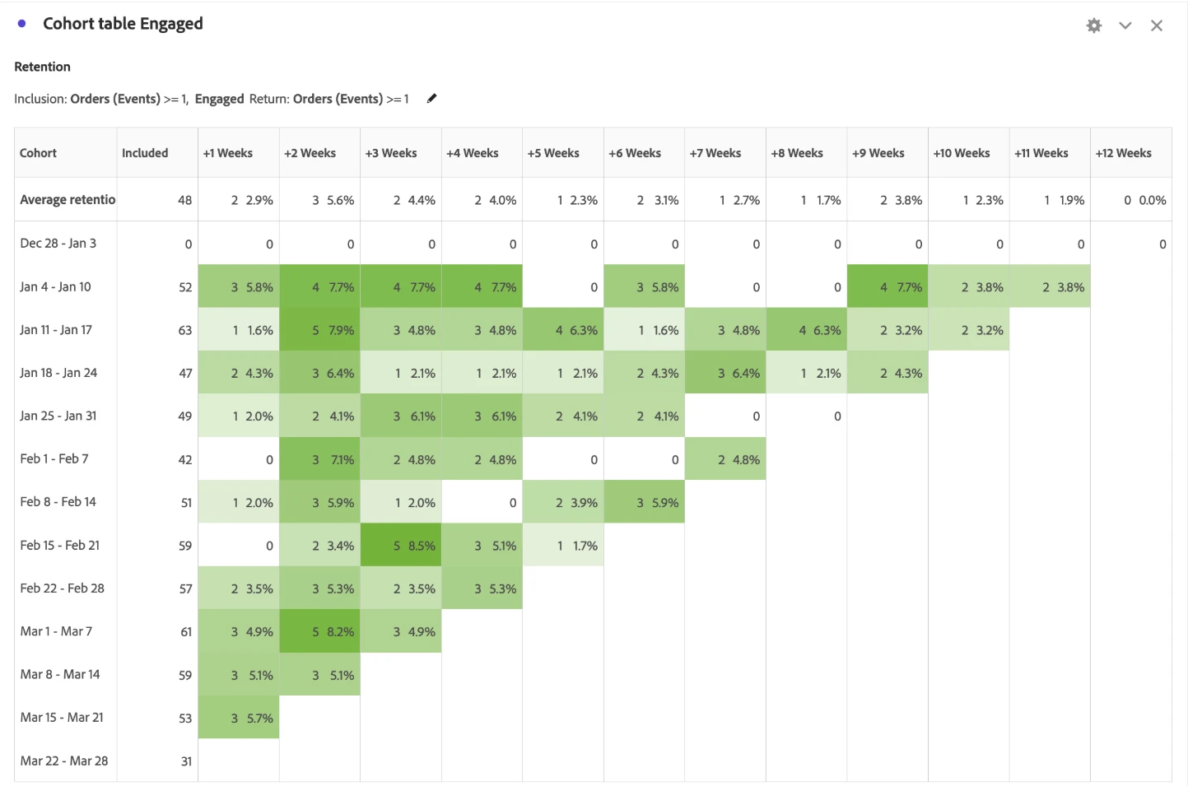
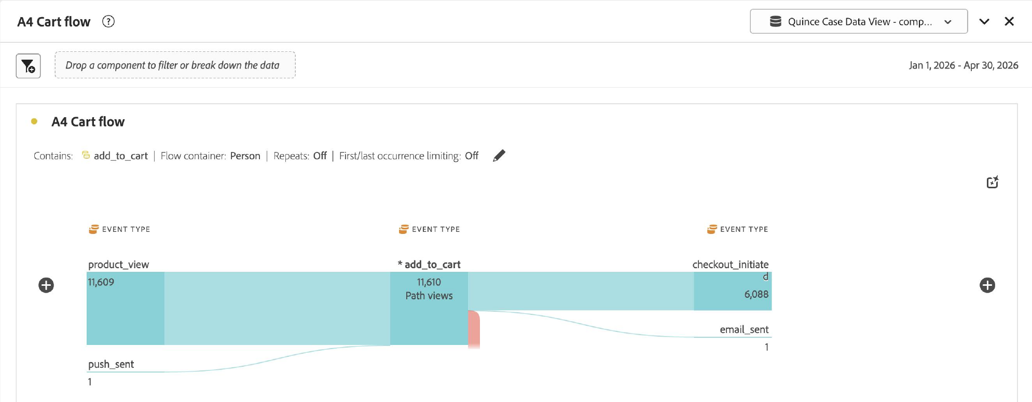
Appendix: four Adobe CJA panels behind every number
G27
1 Fallout
2 Attribution IQ
60,000 people → 2,592 buyers: 69% of product viewers and 77% of cart adders never order.
Owned channels take part in 15.0% of $337K revenue but get 4.8% on last touch; paid channels barely move.
3 Cohort Table
4 Flow
Week-2 return: 5.6% for engaged buyers (right) vs 2.1% for all buyers (left); half of engaged returns land in weeks 1–4.
Of 11,610 add-to-cart paths, 6,088 reach checkout and 1 is followed by an email; the rest get no message.
Source: Adobe CJA, Quince Case Data View, 1 Jan–30 Apr 2026, 60,000 people. Screenshots from the team's project; names and avatars cropped.
Team G27 · 8

